Slide 1
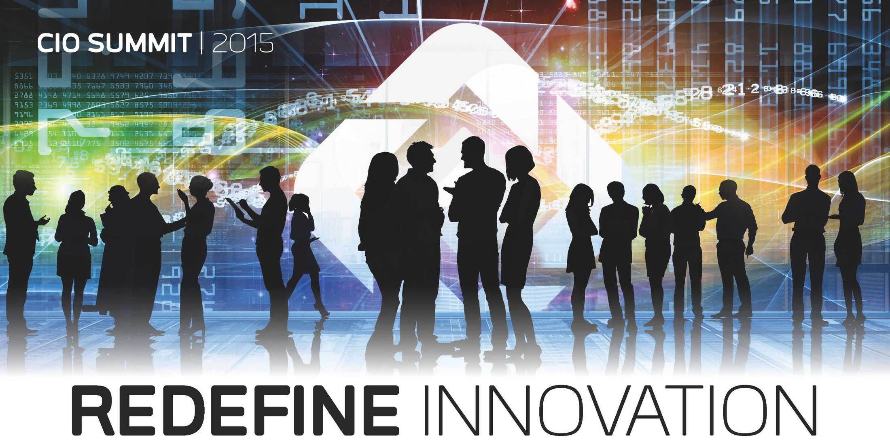

Slide 2
BUSINESS TRANSFORMATION DRIVEN BY THE FEDERATION HYBRID CLOUD
TOM ROLOFF
SVP, GLOBAL SERVICES
EMC II

Slide 3
AGENDA
What’s Driving IT Transformation
Three Levels Of IT Transformation
Infrastructure Transformation
Operating Model Transformation
Application Transformation
Approaches For Starting A Transformation Program
✓
✓
✓

Slide 4
WHAT’S DRIVING IT TRANSFORMATION
Notes:
Our point of view
The world is digital; need the agility to build things like next gen apps quickly; IT needs to be a business enabler not a cost to reduce
Transformation to ITaaS can build that agility; bridges between supporting existing IT requirements while providing the ability to develop new

Slide 5
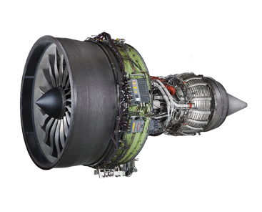
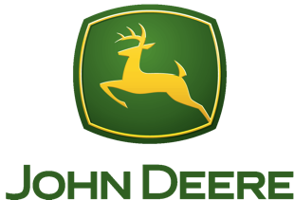
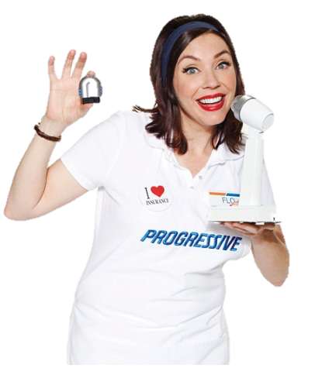
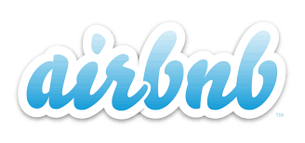
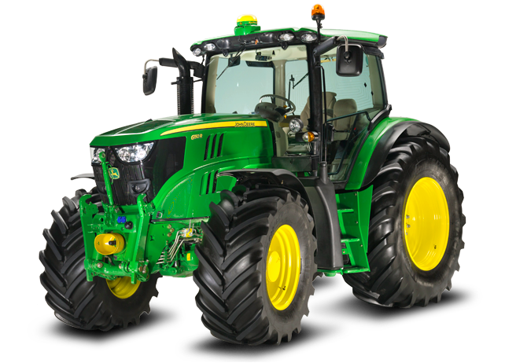
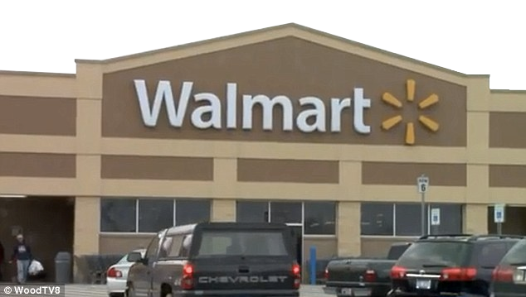
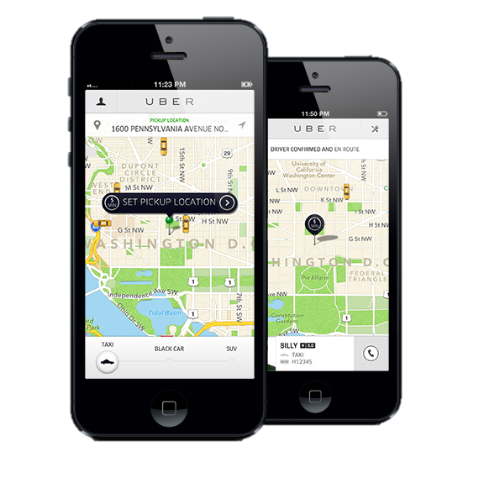
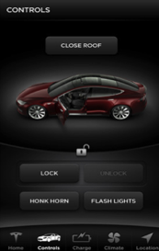
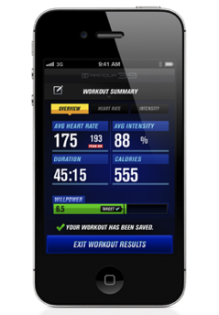
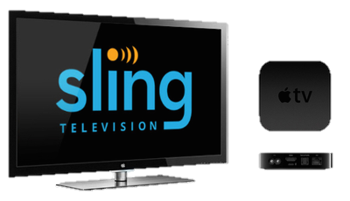
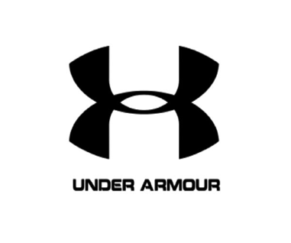
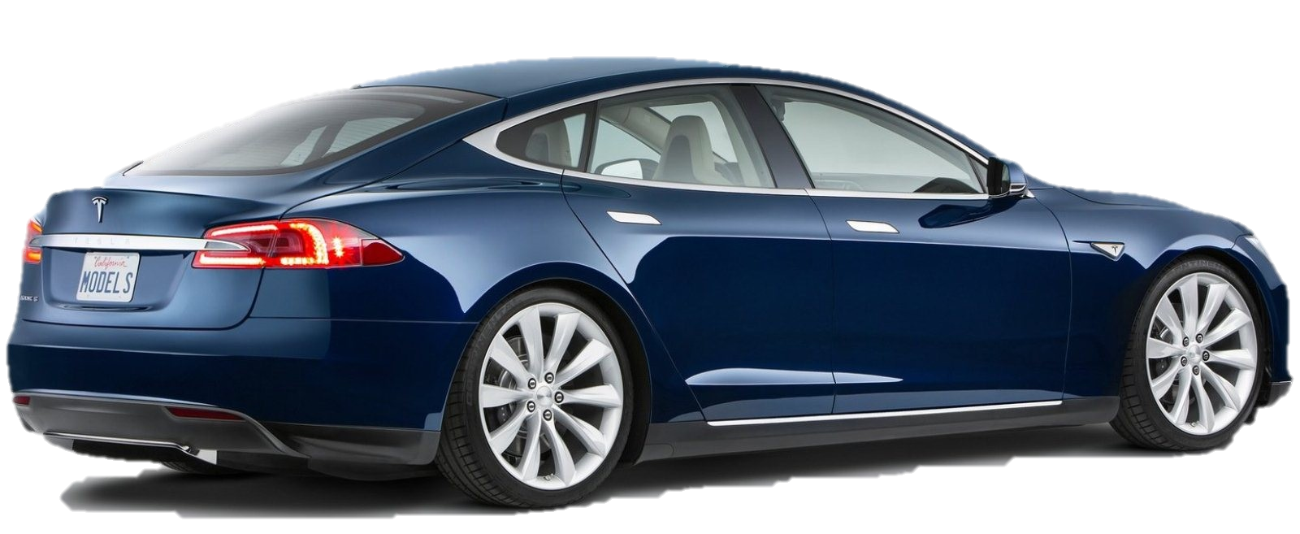
INDUSTRIES & BUSINESSES ARE BEING REDEFINED

Slide 6
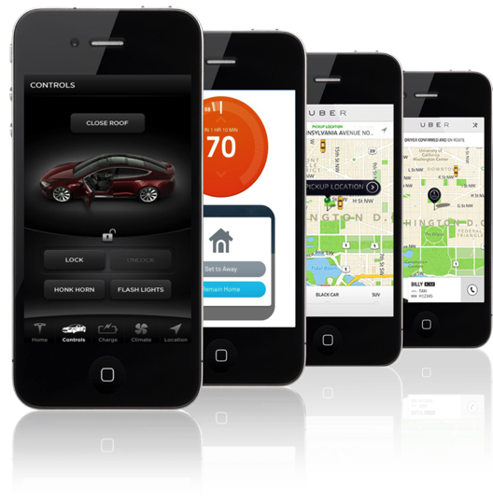
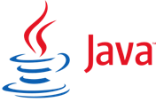
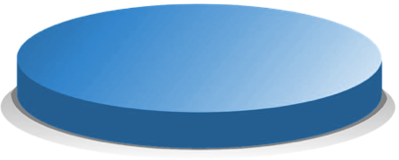
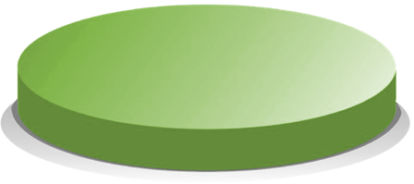
IT NEEDS TO SUPPORT TWO MODES
EXISTING
PLATFORMS
NEW
PLATFORMS
Stable & Reliable Performance To Drive Daily Business Functions
Flexibility & Agility To Drive New Digital Business Outcomes
Notes:
Stable and Reliable Performance to Address the Daily Business Functioning of the Enterprise
Flexibility and Agility to Deliver Innovative Results that Drive New Digitally Business Outcomes

Slide 7
TRANSFORMING INTO A SERVICE BROKER
HYBRID
PRIVATE
PUBLIC
NEW IT BUSINESS MODEL
Service Oriented
Market Driven
“P & L” Focused
Broker & Builder
NEW TECHNOLOGY ARCHITECTURE
Private, Hybrid, Public Clouds
End-To-End Automation
Financial Transparency
Self-Service Capabilities
DNA, SKILLS, ROLES & ORGANIZATIONAL ALIGNMENT
“Front Office” Capabilities
Service Accountabilities
Technology Breadth
Notes:
The case for transformation is really rooted in our legacy – in how we’ve behaved, how we’ve been run, and how we’ve been organized in the past
IT-as-a-Service means taking that virtual hosting platform and layering on top of that some key capabilities involving extensive automation
The real goal is “optimizing IT production for business consumption” – what’s good for IT may not always be what’s good for the business
If we are going to compete with external IT service providers, we have to be organized and operate like IT service providers that can win the business
A New IT Business Model
Now we will focus on transforming to a model that looks more like a professional services organization than a customer services organization
We have to start with the services as opposed to the technology – our clients are not consuming a technology, they are consuming a “business capability”
Enabling Technology
This is probably the easiest of the three, and the main focus of our first two phases
DNA, Skills, Roles & Organizational Alignment – this is our focus now
Important to focus on “front office” capabilities – “front office” meaning the marketing and sale of IT services

Slide 8
IT AS A SERVICE DELIVERS BUSINESS AGILITY AT LOWER COST
IT COST COMPARISON
(% OF TOTAL IT OPEX BUDGET)
INNOVATION SPENDING
(% OF IT BUDGET)
33
Legacy
28%
4
Innovation
20
22
Cloud Services
External Services
Internal Services
Software
Hardware
Telecom, Facilities, Legacy
14
14
Maintenance
6
9
4
27
23
ITaaS
40%+
Legacy
100%
ITaaS
76%
Source: McKinsey, Gartner, EMC analysis
Source: Forrester, EMC analysis
Notes:
How much cost and agility benefit can IT expect from the delivery of IT as a Service?
Regarding cost, the left hand side of this page provides some insight about the amount and nature of costs benefits. IT as a Service can save 20-25% over legacy IT. Notice that the primary savings are not really in hardware, which is a relatively small part of the total budget (shown in light blue), but rather in what is spent on “internal services” and “external services” to customize and operate legacy IT environments.
In terms of agility, the right hand size of this page provides an indication of the amount of the IT budget can be spent on innovation vs. maintenance. With IT as a Service, IT organizations can spend more than 40% of their budget on innovation vs. 28% in legacy IT environments.

Slide 9
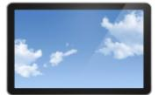
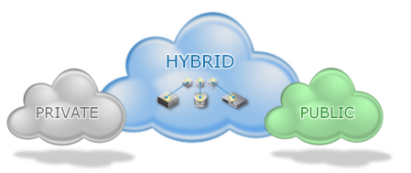
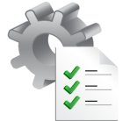
AN IT TRANSFORMATION APPROACH
APPLICATION
TRANSFORMATION
OPERATING MODEL
TRANSFORMATION
Align Workloads With Most Suitable Cloud Model
End User Experience
Service Portal
New Roles
Existing
Applications
New Applications
Package And Orchestrate Services For Agile IT Operations And Convenient Consumption
INFRASTRUCTURE TRANSFORMATION
Build A Cost-efficient, Agile Infrastructure To Enable Hybrid Cloud
Management, Orchestration
Agile Processes

Slide 10
THREE LEVELS OF IT TRANSFORMATION INFRASTRUCTURE TRANSFORMATION
Notes:
New name; enterprise hybrid cloud is only for the VMware version.
“EMC Enterprise Hybrid Cloud, Federation SDDC Edition” is now simply called “Federation Enterprise Hybrid Cloud”.
In addition, the Federation solution formerly known as “Federation Software-Defined Data Center” will now also be called “Federation Enterprise Hybrid Cloud”. They are the same solution; hence they now have the same name.
And if you’ve been using the logo, it’s changed.

Slide 11
TECHNOLOGY TRANSFORMATION—HYBRID CLOUD
BUILD…
GOVERNANCE, RISK AND COMPLIANCE (GRC)
SECURITY
Cloud Services
Policy Engine
Service Catalog
User Portal
Service
Management
BPaaS
SaaS
Request Management
Cloud Service Building Blocks
Incident Management
PaaS
Orchestration Engine
Problem Management
IaaS
Event Management
Traditional (Non-Cloud) Services
Knowledge Management
Cloud Service Broker (CSB)
Change Management
API
API
API
Virtual Infrastructure
Virtual Infrastructure
Virtual Infrastructure
Device
Network
Professional Services
Configuration Management
Physical Infrastructure
Physical Infrastructure
Physical Infrastructure
Hosting
Software
CMDB
Asset Management
PUBLIC CLOUD
HOSTED
PRIVATE CLOUD
PRIVATE CLOUD
Metering Engine
AMDB

Slide 12
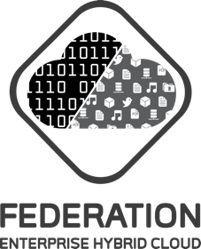
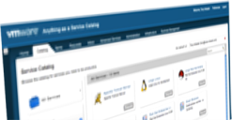
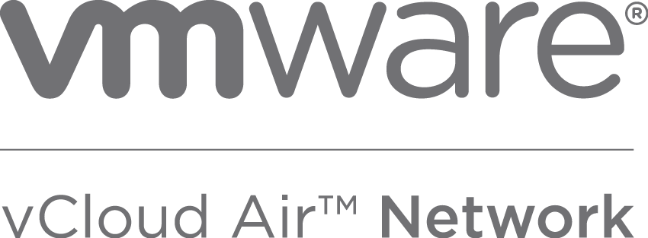
FEDERATION ENTERPRISE HYBRID CLOUD SOLUTION
BUY…
Self-Service & Automation
Virtualized Infrastructure
EMC Cloud Service Providers
Operational
Management
Financial
Transparency
Compute
Network
Software-Defined Storage

Slide 13
THREE LEVELS OF IT TRANSFORMATION OPERATING MODEL TRANSFORMATION
Notes:
New name; enterprise hybrid cloud is only for the VMware version.
“EMC Enterprise Hybrid Cloud, Federation SDDC Edition” is now simply called “Federation Enterprise Hybrid Cloud”.
In addition, the Federation solution formerly known as “Federation Software-Defined Data Center” will now also be called “Federation Enterprise Hybrid Cloud”. They are the same solution; hence they now have the same name.
And if you’ve been using the logo, it’s changed.

Slide 14
NEW IT OPERATING MODEL
NEW ORGANIZATION & ROLES IN IT TRANSFORMATION
SUPPLY
BUSINESS
DEMAND
Department
Department
Department
Department
Department
Department
Department
Demand
Demand
Demand
Demand
Demand
Demand
Demand
BUSINESS RELATIONSHIP MANAGEMENT (BRM)
SERVICE PORTFOLIO MANAGEMENT
IT Portal Service Catalog Solution Desk
SERVICE OPERATIONS
Monitor, Support, Measure, Improve Services
Supply
Supply
Supply
Supply
“ELASTIC IT” SUPPLY
IT Service Center
IT Service Center
IT Service Center
SP Service Center
Notes:
New the IT Operating model is fundamentally about delivering value to the business. The principles of supply and demand are at its core as the Business Relationship Manager looks to capture and predict what the business needs (in their terms) and communicate that to the rest of the newly organized IT operations. Moving from the old model of order taking to a more proactive opportunity sharing approach.
The portfolio and ops groups sit in-between the BRM and the supply, or technology layer of IT. They ensure that the demand needs are met via a set of standardized services organized in a service catalog and delivered via a self-service portal. These standardized services reduce the tendency towards one off projects and shift towards managing a portfolio of service.
Operations ensures the day to day operations and timely delivery of services. No longer is IT seen as taking weeks to months to respond to changes, but rather a continuous delivery. Ops also focuses on the measurement of the service usage and reports back to the business units on how and where their services are being used to better serve the business.
At the foundation is the supply layer of IT Service Centers structured around important areas of focus. They work in tandem to share component parts and adjust capacity based on demand. These service centers can rely on internal or even external components and services to deliver back up to the business. Many customers choose to create a specific service center to aggregate external service providers so business unit usage of these resources is monitored and managed alongside internal operations. There is one view of IT and technology that the business interacts with.
This new operating model changes the dynamic of IT to all about delivering value to the business.

Slide 15
THREE LEVELS OF IT TRANSFORMATION APPLICATION TRANSFORMATION
Notes:
New name; enterprise hybrid cloud is only for the VMware version.
“EMC Enterprise Hybrid Cloud, Federation SDDC Edition” is now simply called “Federation Enterprise Hybrid Cloud”.
In addition, the Federation solution formerly known as “Federation Software-Defined Data Center” will now also be called “Federation Enterprise Hybrid Cloud”. They are the same solution; hence they now have the same name.
And if you’ve been using the logo, it’s changed.

Slide 16
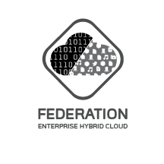
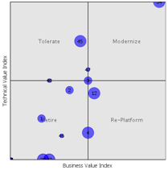
APPLICATION TRANSFORMATION
ANALYZE
DETERMINE
EXECUTE
New
Applications
BUILD NEW
DEVOPS FACTORY
DEV
DEV
OPS
REINVEST
Architecture, Standards
Dev,
Execution
APPLICATION PORTFOLIO ANALYSIS
APP MIGRATION FACTORY
REPLATFORM
Existing Applications
Architecture, Standards
Migration
Execution
RETIRE
RETIREMENT FACTORY
Application
Inventory &
Classification
Application
Alignment
RETAIN
Architecture, Standards
Retirement
Execution

Slide 17
APPROACHES FOR STARTING AN IT TRANSFORMATION
Notes:
Our point of view
You can approach IT transformation through a tops-down approach driven by senior management with a documented business case and roadmap; or you can take a step-by-step journey mapped out in a prioritized fashion.
First we’ll discuss an ITTW that helps set priorities and drives alignment.
Then we’ll review a tops-down approach with senior management driving an ITaaS roadmap and bus. case approach.

Slide 18
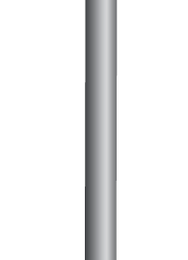
IT’S A JOURNEY—STEP BY STEP
Financial Transparency
User Portal
Service Catalog
Converged Infrastructure
Virtualization
STEP BY STEP

Slide 19
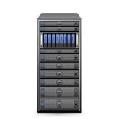
IT TRANSFORMATION—DEFINE THE FUTURE—& WORK BACKWARDS
FUTURE
VISION
Current State
TOPS DOWN MILESTONES DEFINED

Slide 20
THANK YOU

